Slide 1

HIRING PROCESS ANALYTICS

Slide 2
Project Description
This project aims to conduct a comprehensive analysis of various aspects of the company's workforce. It begins by examining the gender distribution of new hires, followed by an evaluation of the average salary offered by the company.
Additionally, the project involves creating class intervals to understand the distribution of salaries across different ranges.
Visualizations, such as pie charts and bar graphs, will be utilized to illustrate the proportion of employees in different departments and the distribution of positions across various tiers within the company.
Through these analyses, valuable insights will be gained to inform decision-making processes and optimize workforce management strategies.

Slide 3
Methodology Overview
The approach for this project involves several steps to systematically analyze different aspects of the company's workforce.
Hiring process analysis sheet
Data Collection
Data Preparation
Hiring Analysis
Salary Analysis
Salary Distribution
Departmental Analysis
Position Tier Analysis
Insights

Slide 4

Tech-stack used
Microsoft Office Excel 2007
(12.0.6787.5000)
SP3 MSO (12.0.6607.1000)
Microsoft Excel 2007 is a suitable and capable tool for conducting comprehensive data analysis and visualization, which will be beneficial in deriving meaningful insights for the hiring process improvement project.
Microsoft Excel 2007 is a suitable and capable tool for conducting comprehensive data analysis and visualization, which will be beneficial in deriving meaningful insights for the hiring process improvement project.

Slide 5
Descriptive Statistics
Mean | 49878.34641
Median | 49625
Mode | 69583
Range | 99867
Maximum | 99967
Minimum | 100
Sum | 357378352
Count with outliers | 7168
Hired | 4697
Rejections | 2471
Outliers found | 3
Count without Outliers | 7165

Slide 6

Hiring Analysis
Calculating the males and females hired by Google.
Gender | Hired
Males | 2572
Females | 1854
Hired Males > Hired Females

Slide 7
Salary Analysis
Average Salary: Sum of salaries / Count of number of employees
Sum of offered salary | 357378352
Count of application Id | 7165
Average Salary | 49878.346
=SUM('data without outliers'!G2:G7166)
/COUNT('data without outliers'!A:A)
Average Salary of an employee is 49878.346

Slide 8
Salary Distribution
Analysis of salary ranges and their distribution within the company.
Bin | Frequency
100-10100 | 1
10100-20100 | 685
20100-30100 | 728
30100-40100 | 712
40100-50100 | 712
50100-60100 | 777
60100-70100 | 754
70100-80100 | 698
80100-90100 | 733
90100-100100 | 716
100100-110100 | 649
Maximum offered salary: 99967
Minimum offered salary:100
Maximum – Minimum: 99867
Class interval size: 10000
Number of intervals: 11

Slide 9
Employees offered a salary range within 50,100 to 60,100 are higher than others.

Slide 10
Departmental Analysis
The proportion of people working in different departments.
Department | Hired
Finance Department | 176
General Management | 111
Human Resource Department | 70
Marketing Department | 201
Operations Department | 1843
Production Department | 246
Purchase Department | 230
Sales Department | 484
Service Department | 1330

Slide 11
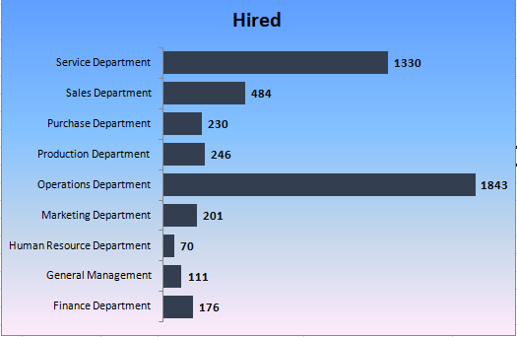
Bar Graph helps us to visualize the proportion of employees in different departments
Operations Department has higher number of employees hired.

Slide 12
Position Tier Analysis
This helps understand the hierarchical structure of
the organization and the distribution of roles across
different levels.
Post Name | Hired
b9 | 307
c5 | 1182
c8 | 193
c9 | 1240
cc910 | 105
i1 | 151
i4 | 31
i5 | 510
i6 | 337
i7 | 633
m6 | 2
m7 | 0
n10 | 0
n6 | 1
n9 | 0
=COUNTIFS('data without outliers'!F2:F7166,
Table5[[#This Row],[POSITIONS ]],
'data without outliers'!C2:C7166,
Table5[[#Headers],[Hired]])

Slide 13
Column graph to represent the different tiers of positions within the company
C9 has employed the highest number of individuals, while m7,n10,n9 has employed the fewest.

Slide 14
Key Takeaways
Hiring Analysis: The gender distribution of new hires tells us that number of males hired are more than females hired.
Salary Analysis: The average salary of employees is 49878.346.
Salary Distribution: Employees offered a salary range within 50,100 to 60,100 are higher than others.
Department Analysis: Operations Department has higher number of employees hired.
Position Tier Analysis: C9 has employed the highest number of individuals, while m7,n10,n9 has employed the fewest.

Slide 15
Thank you…

